Slide 1
The Normal Distribution
A Beginner’s Guide to the Bell Curve

Slide 2

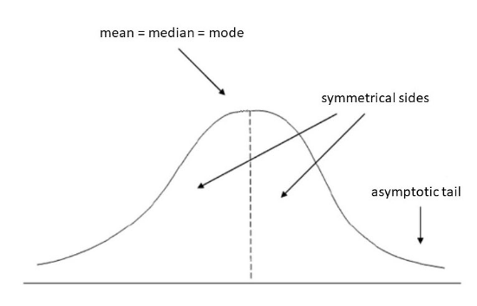
What is a Normal Distribution?
Often called the Bell Curve, it is a symmetric probability distribution where most observations cluster around the central peak.
Think of it as the "Natural Law" of data—it appears everywhere, from heights and IQ scores to error measurement.

Slide 3






Three Core Properties
Symmetry
The Center
Total Area
The left side is a perfect mirror image of the right. There is no "skew" to either side.
The Mean, Median, and Mode are all exactly the same value at the center of the curve.
The total area under the curve is always equal to 1.0 (or 100% of all possible data points).

Slide 4

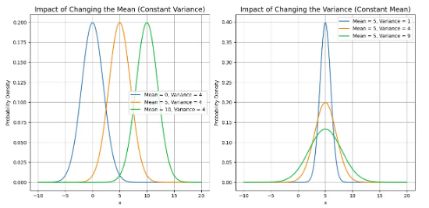
The "Center": Role of the Mean
The Mean (μ) acts as the anchor of the distribution. It tells us exactly where the peak of the curve is located on the horizontal axis.
Changing the Mean:
Increasing the mean shifts the entire curve to the right. Decreasing it shifts it to the left. The shape remains identical!

Slide 5
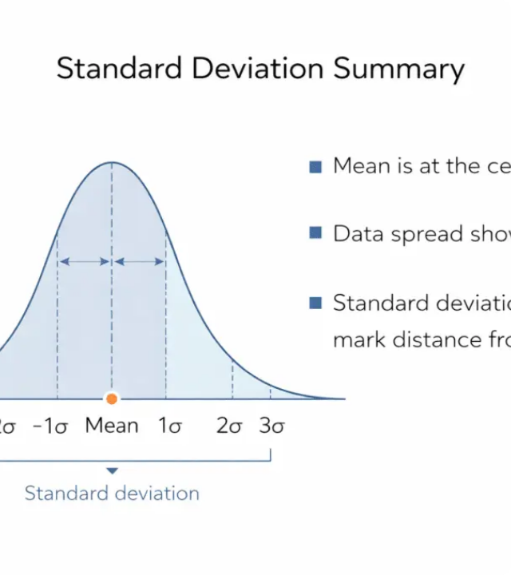
The "Spread": Standard Deviation
The Standard Deviation (σ) determines the width and height of the curve.
Small σ: Data is tightly packed around the mean. The curve looks tall and skinny.
Large σ: Data is widely spread out. The curve looks short and fat.

Slide 6
The Empirical Rule
Also known as the 68-95-99.7 Rule, this tells us exactly how much data sits within specific distances from the center.

Slide 7
Predictable Percentages
68%
95%
99.7%
Within 1 σ
Within 2 σ
Within 3 σ
Nearly two-thirds of all data points fall within one standard deviation of the mean.
The vast majority—95%—of data points fall within two standard deviations.
Almost all data (99.7%) is captured within three standard deviations. Outliers are rare!

Slide 8

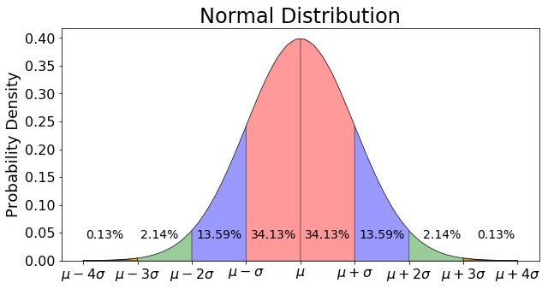

Slide 9

Standardizing with Z-Scores
A Z-score tells us exactly how many standard deviations a data point is from the mean.
Z
The Standard Score
Positive Z-scores are above average; negative scores are below average.

Slide 10
How to Calculate a Z-Score
Scenario: You scored 1200 on an exam where the Mean (μ) is 1000 and the SD (σ) is 100.
Step 1: Find the difference from the mean (1200 - 1000 = 200).
Step 2: Divide by the standard deviation (200 / 100 = 2).
The Result: Your Z-score is 2.0. You are exactly 2 standard deviations above the mean!
Insight: According to the Empirical Rule, you performed better than 97.5% of people.

Slide 11
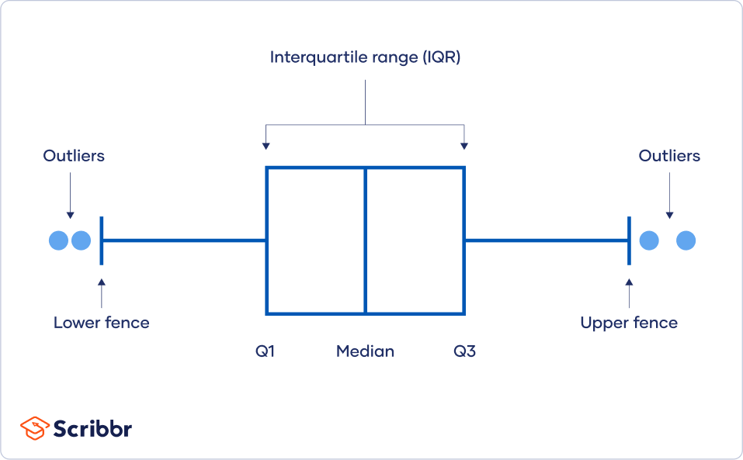
The Interquartile Range (IQR)
The IQR measures the "Middle 50%" of your data—from the 25th percentile (Q1) to the 75th percentile (Q3).
Q1 & Q3
The IQR Calculation
In normal data, Q1 is approximately μ - 0.6745σ and Q3 is μ + 0.6745σ.
IQR = Q3 - Q1
The IQR is approximately 1.349 × Standard Deviation (σ).

